Slide 1
SEEM3510
Two Human-Computer Interaction Systems
Speech Recognition and Speech Synthesis
Yuejiao WANG, Prof. Helen Meng
Notes:
Today, I will show you two human-computer interaction systems. As we know, speech is the most common tool for us to communicate with each other. But if we would like to communicate with computers, speech can’t be understood by the computers directly. So it is very important to convert speech to text and converted text to speech.
For example, when you want apple siri to help you set a alert. The whole procedure is:
First, speech to text. Text is “wake me up at 6 o'clock”.
Second, Natural Language Processing.
Third, natural language processing’s result will be an response of text, it could be: “okay, I set it for 6 am” , but it should be read by the smart phone, then it need text to speech.
Today, I will focus on the first and third parts. Speech to text is also called speech recognition. Text to speech is also called speech synthesis.
https://www.youtube.com/watch?v=SpGJNPShzRc 2:12—2:24.

Slide 2
Introduction of ASR
Automatic Speech Recognition (ASR) provides several capacities:
Convert speech into text (i.e. transcribing)
Detect any keywords spoken (i.e. keywords spotting): Useful in many aspects
ASR involves many technologies like
ASR technology: Corpus building, language model, grammars, statistic modelling and others
Notes:
First, Let’s talk about the Automatic Speech Recognition.
Keywords spotting is very useful in many aspects, for example, If you are a safety member in FBI, and you want to detect whether there’s something unsafe potentially, then you can use the keywords spotting technique to detect somebody’s phone call. If you detect some words such as “kill Trumps”……. Then, you will have some other things to do.
Many technologies are involved into ASR, like corpus building, language model and so on.
Today, I will show you an IBM demo of ASR. It includes two tasks, one is…..

Slide 3
Difficulties in ASR
Differences between speakers: inter-speaker variability
physiological, accent/ dialect etc
Differences in how a speaker utters the same word/ sentence intra-speaker variability
different styles of speech (prepared, spontaneous, casual, whispered, etc)
a person’s speech changes over time (aging) and transitory effects (a cold)
Acoustic channel & noise - microphone differences, background noise
Need to model language in general and of particular domain

Slide 4
Task Complexity
Tasks are typically constrainded to limit the variability by:
isolated word format
limited vocabulary
constrained syntax
low noise conditions
Input mode: discrete vs. continuous speech
voabulary size: small (<200 words) to very large (>60k words)
basic unit: acoustic model units
grammar: assigns a probability possible word sequences

Slide 5
Task Complexity
Speaker mode: speaker dependent (SD) vs speaker independent (SI) vs speaker adaptive (SA)
Microphone: close vs far-field; fixed vs variable; bandwidth
Background noise: clean vs noisy
Channel: high quality/ std telephone
Speaking style: prepared/ read/ careful
Languages: most work in English.

Slide 6
Demonstration App
Open Google Chrome
Remind: The demonstration app ONLY supports Google Chrome and Firefox. Don’t use IE
Go to the link:
https://speech-to-text-demo.mybluemix.net/
Notes:
Now, let’s try it.

Slide 7
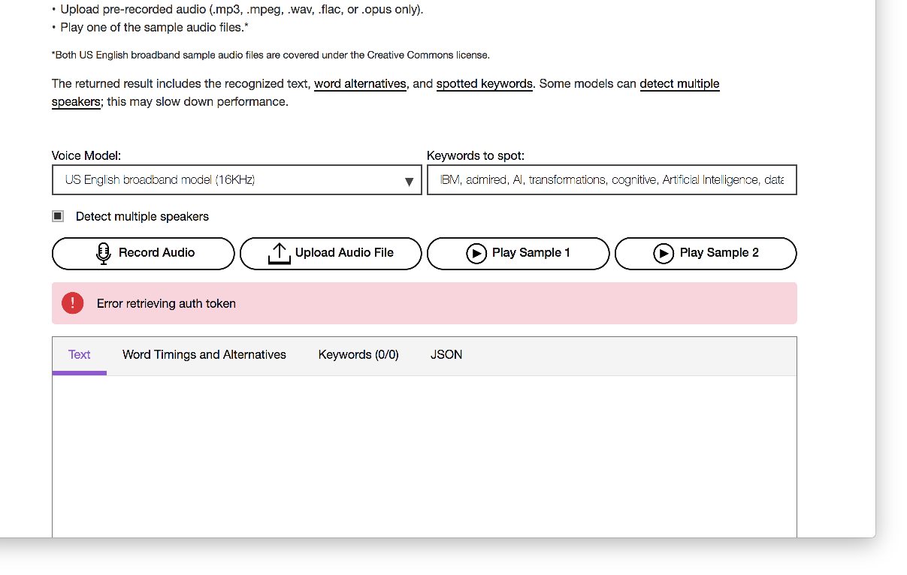
Homepage
Notes:
After you open it, you will see the homepage like this.
Let’s first try the sample which is provided by IBM.

Slide 8
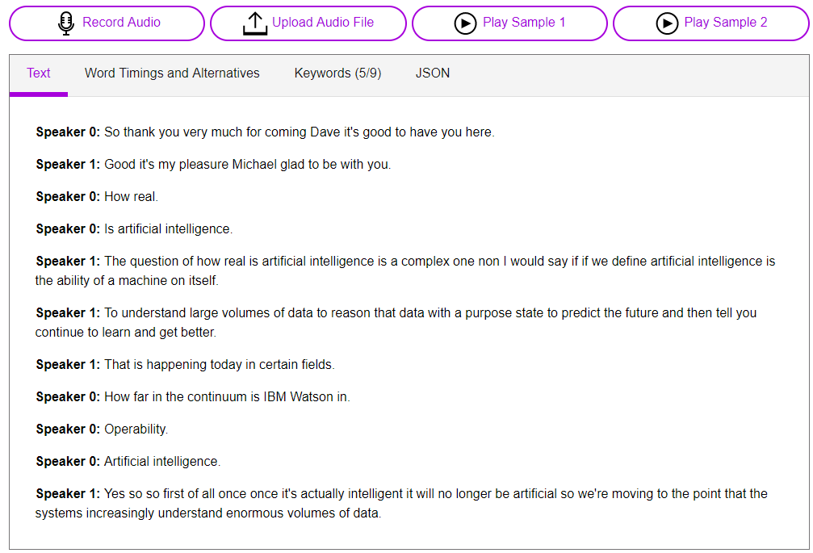
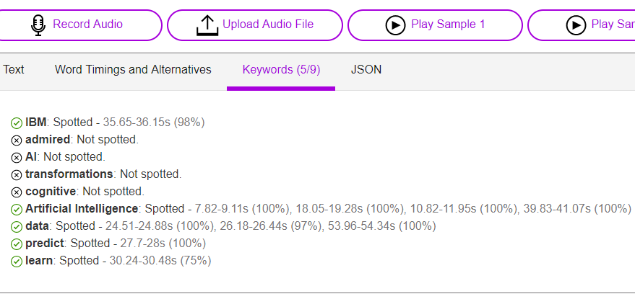
Sample demonstration
Text:
Real-time text contents with speaker labels
2. Keywords:
Keywords spotted with time span
Notes:
You can click the “play sample1” and see the result as the figure on the left.
If you want to try the keywords spotting task in this sample, you can click the keywords. And you will see the result as the figure on the right.

Slide 9
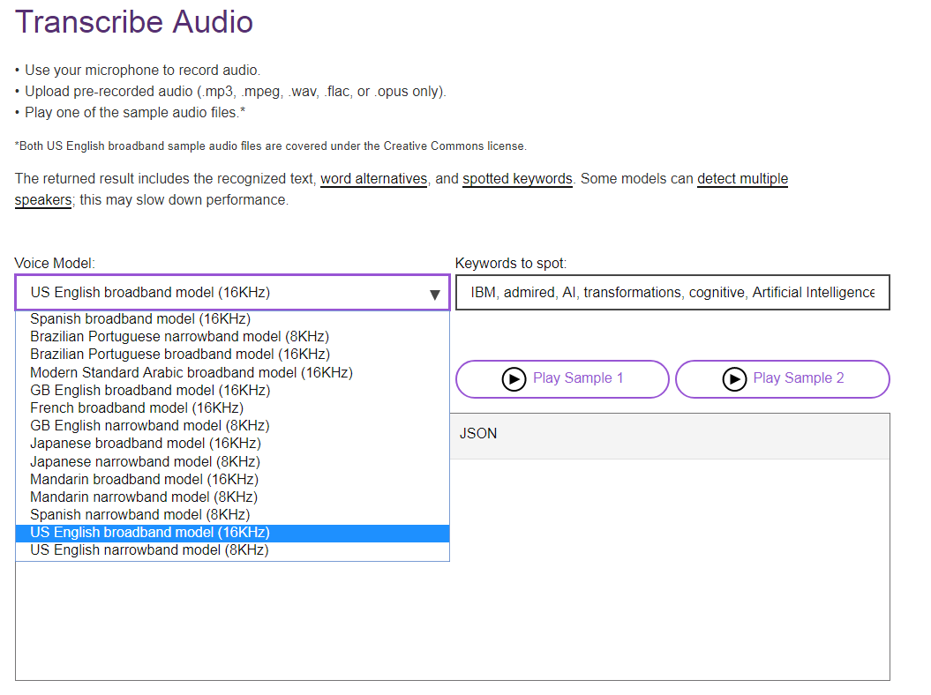
Real-time transcription task
1. Select the language
Reminder: Please select 16KHz, which is our microphone configuration
Notes:
For this demo, you can also record audio using your own microphone or upload pre-recorded audio files.
Now, we can try it.

Slide 10
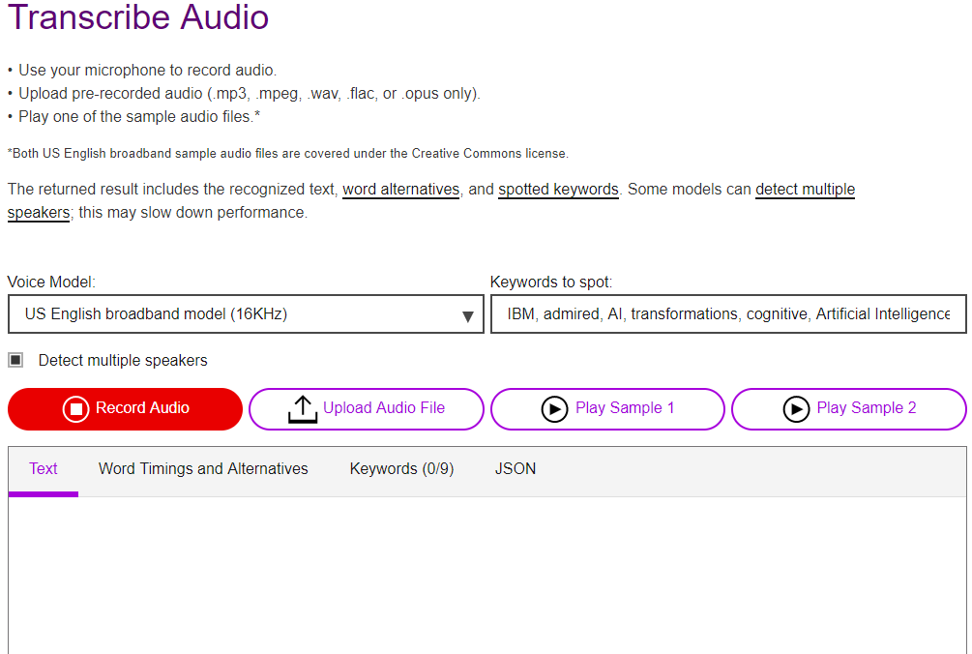
Real-time transcription task
2. Start by clicking “Record Audio”

Slide 11
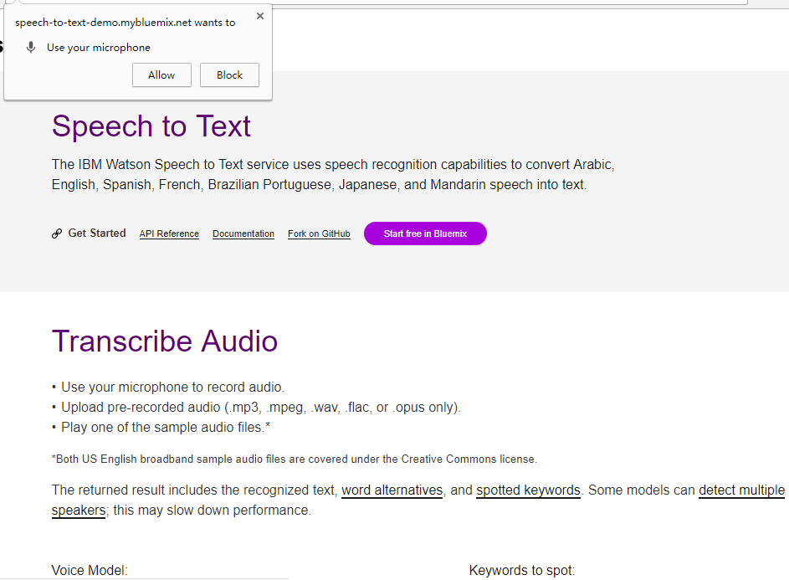
Real-time transcription task
3. Click “Allow”

Slide 12
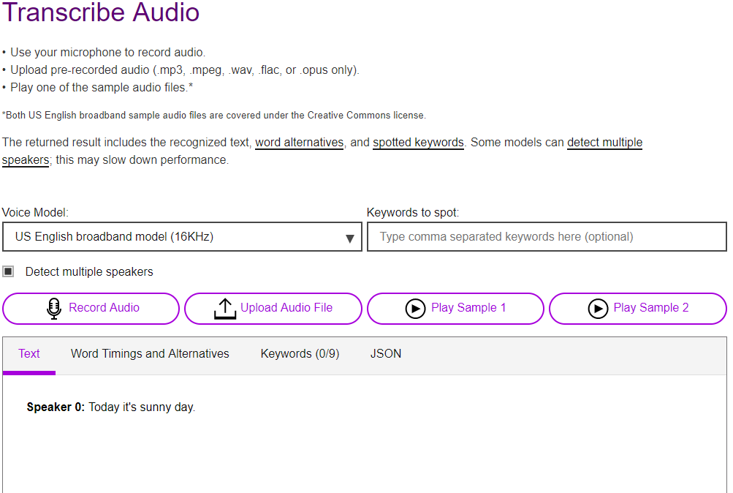
Real-time transcription task
4. Record your speech. The result will be shown here

Slide 13
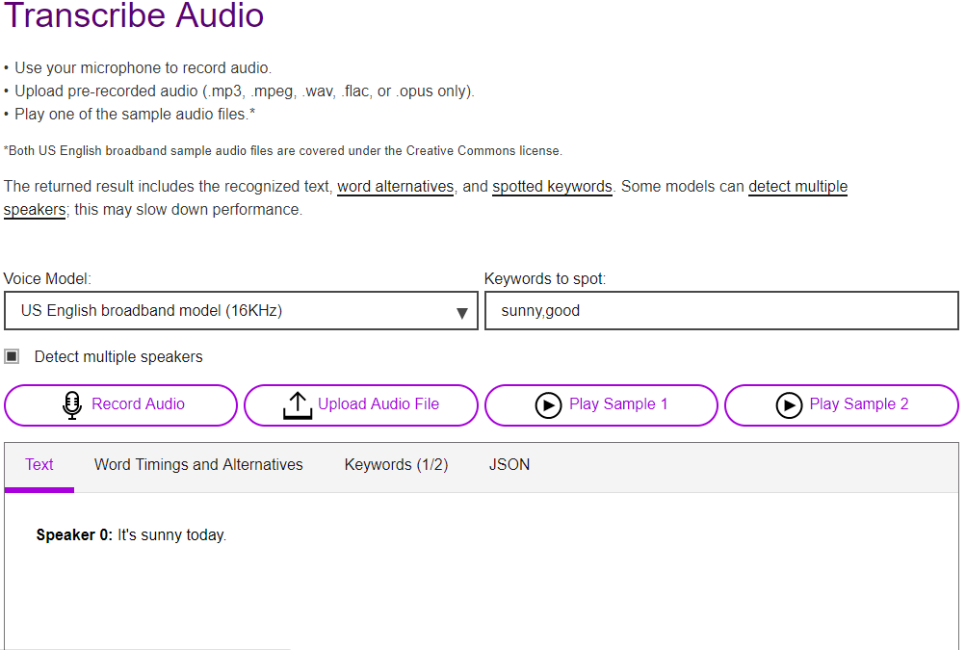
Keywords Spotting task
1. Refresh the page
2. Select the language
3. Type in keywords, separate by comma
4. Start by clicking “Record Audio”, Record your speech containing one or more of the input keywords.
Remark:
Input keywords before clicking the “Record Audio”
Notes:
You can also try the keywords spotting task with your own speech.
Just follow these steps
First….

Slide 14
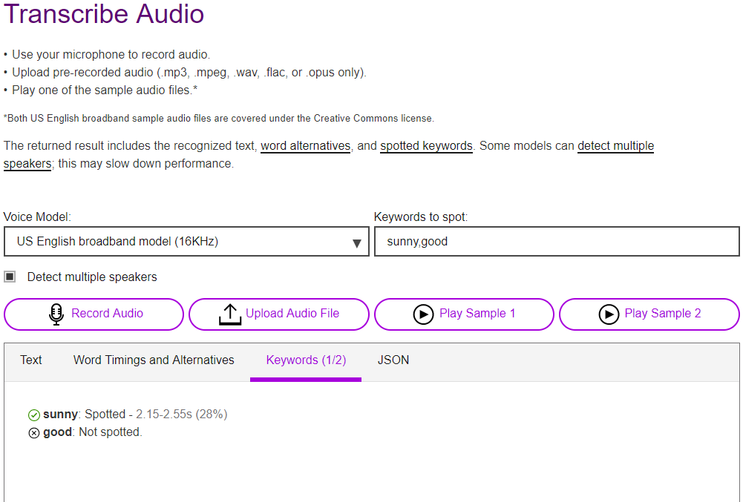
Keywords Spotting task
5. The result will be shown here.

Slide 15
Introduction of TTS
Speech Synthesis, Text to Speech (TTS), converts text into natural-sounding speech
TTS involves many technologies like
TTS technology: wave synthesize, language analyze, expressive synthesize and so on…
TTS research, it is not only speak out the text
Express the emotion by prosodic variation
Happy, bad, uncertain, etc.
Present in different styles
Speak faster, higher pitch, etc.
IBM provides two solutions
Expressive SSML (Speech Synthesis Mark-up Language)
Voice Transformation
Notes:
Next, Let’s go on to the TTS.
In TTS research, it is not only speak out the text. Sometimes, we need to express the emotions, such as, happy, angry, bad, uncertain. And sometimes, the speech should be presented in the different styles, like speaking faster in higher pitch.
IBM provides two solutions: expressive TTS and voice transformation.
Today, we will try this two solutions from IBM

Slide 16
Demonstration App
Open Google Chrome
Remind: The demonstration app ONLY supports Google Chrome and Firefox. Don’t use IE
Go to the link:
https://www.ibm.com/demos/live/tts-demo/self-service/home
Notes:
Again, we need to open google chrome, and go to this link.

Slide 17
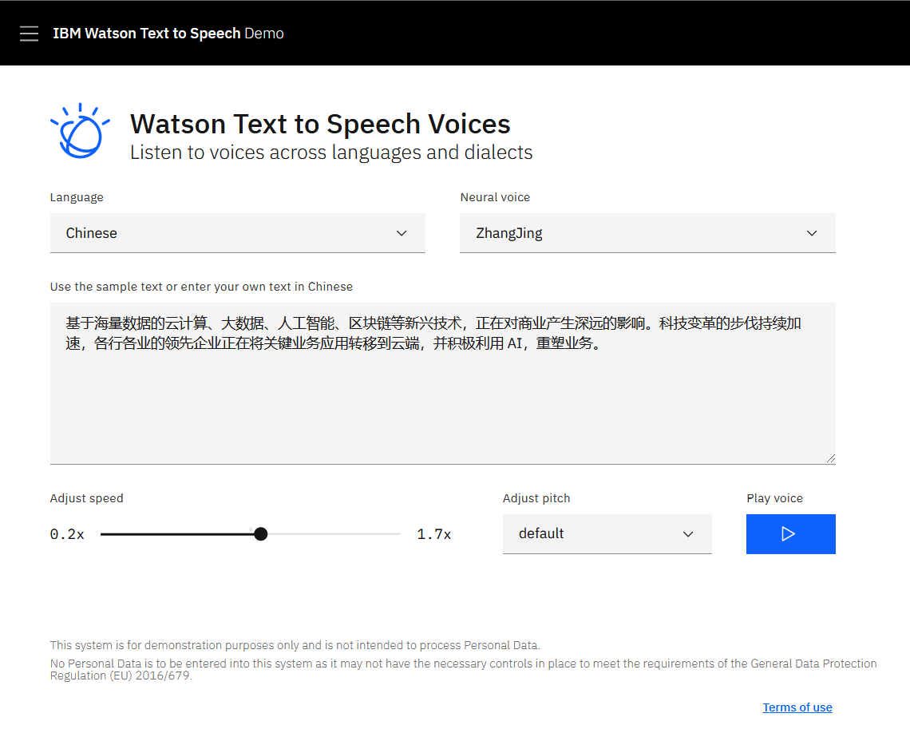

Slide 18
References
Speech to Text Detail API Reference: https://cloud.ibm.com/docs/services/speech-to-text?topic=speech-to-text-about
Text to Speech Detail API Reference: https://cloud.ibm.com/docs/services/text-to-speech?topic=text-to-speech-about

Slide 19
Thank you!

